Slide 1



Parameter Fitting:
Overview
Joseph L. Hellerstein^{1,2} and Herbert M. Sauro³
¹eScience Institute
²Department of Computer Science & Engineering
³Department of BioEngineering
October, 2022

Slide 2
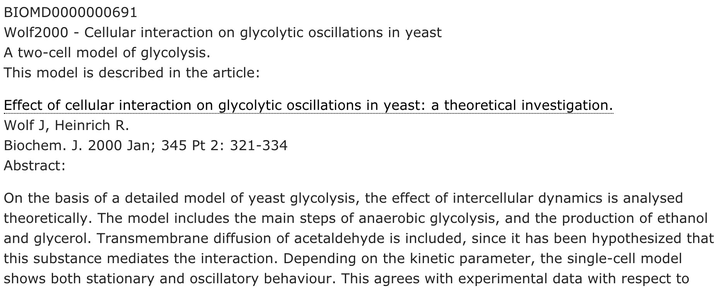
What’s Parameter Fitting? Why is it important?

Slide 3
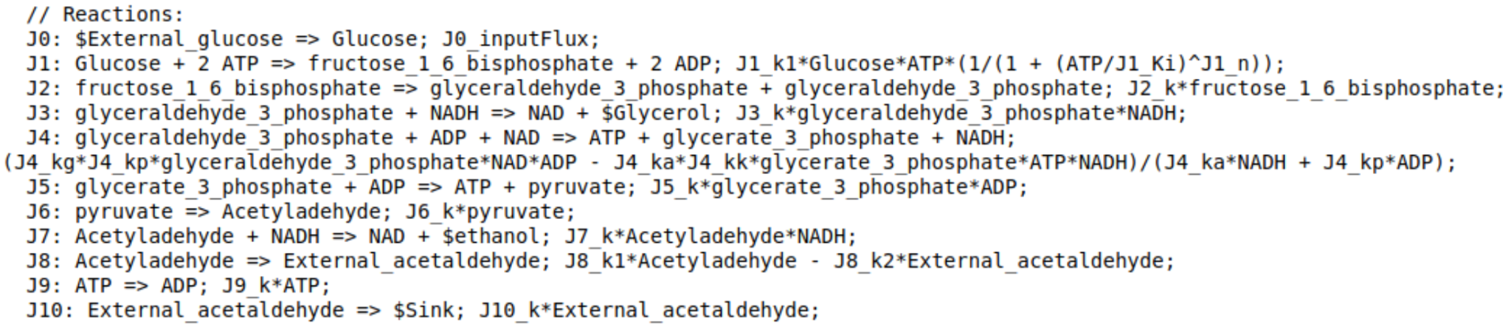
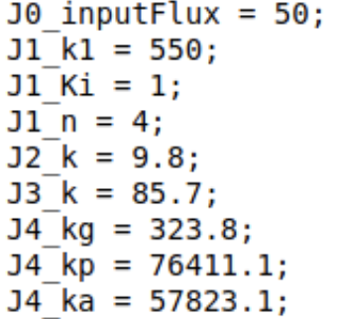
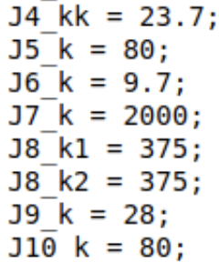
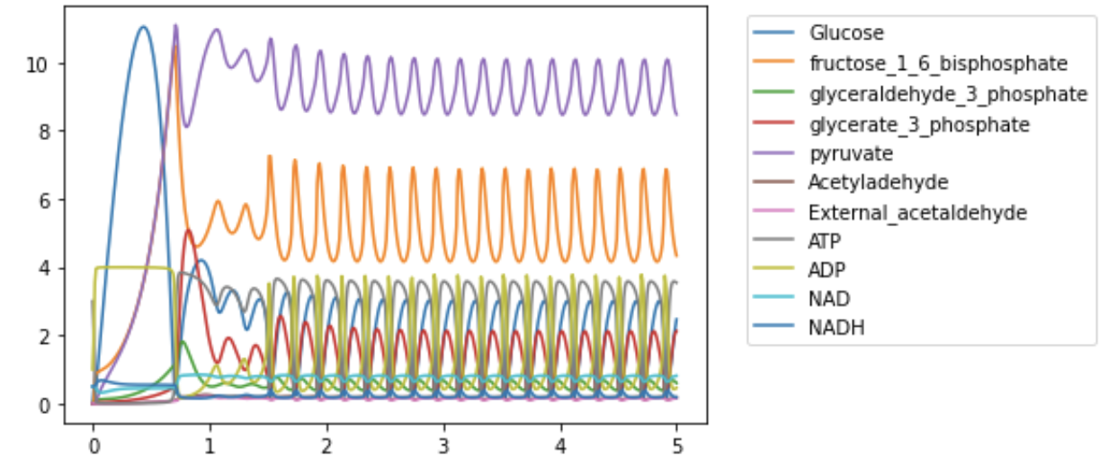
Wolf2000 Model of Glycolytic Oscillations
Model Parameters and their settings in the published work.
Notes:
Emphasize that the parameters permeate the model.

Slide 4
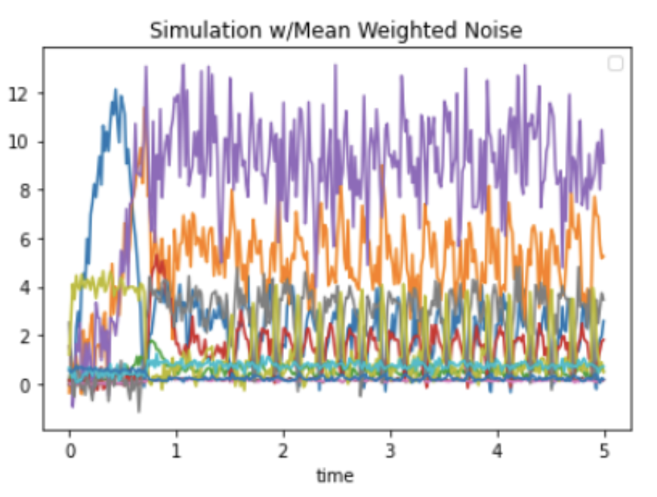
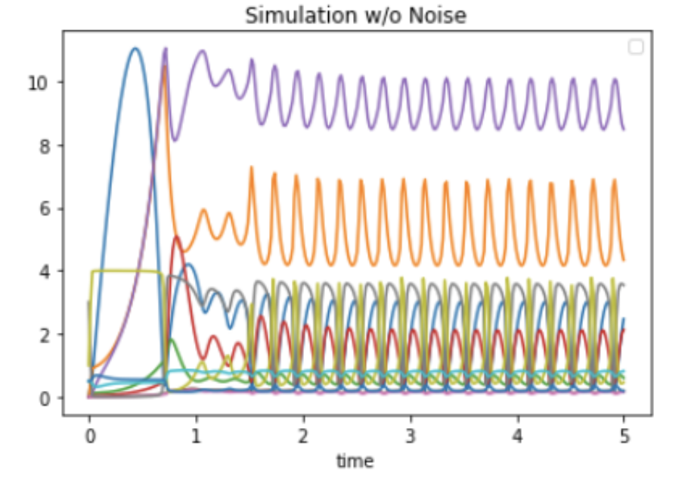
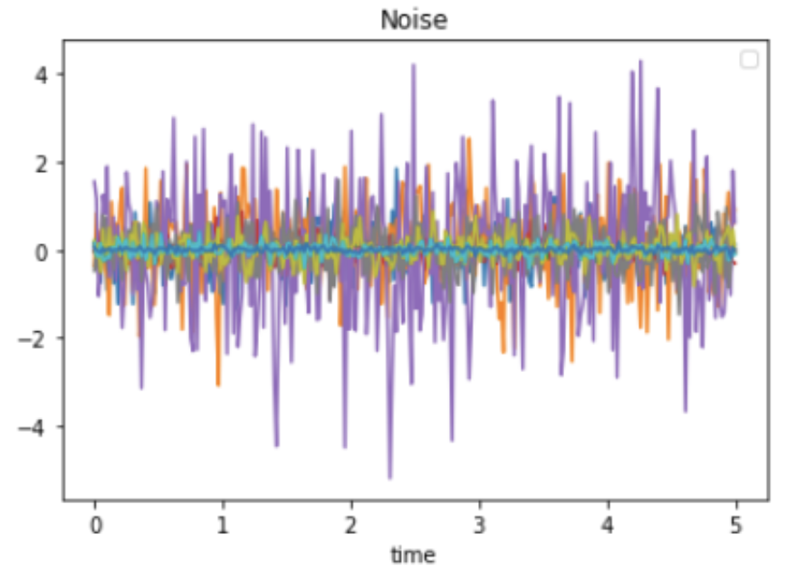
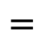
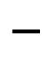
Fitting Basics
Objective
Find values of parameters that make the model fit observed data.
Residuals
Difference between observed values of data (floating species) and simulated values
Parameter fitting is an optimization:
Choose parameter values that minimize the residuals
Simulation results for an assignment of values to parameters
Residuals
Observational data
Observational Data
$$−$$
$$=$$

Slide 5
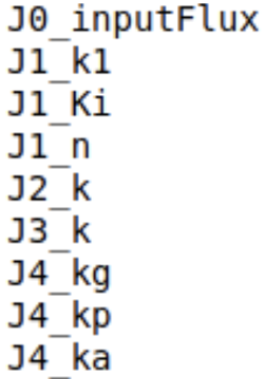
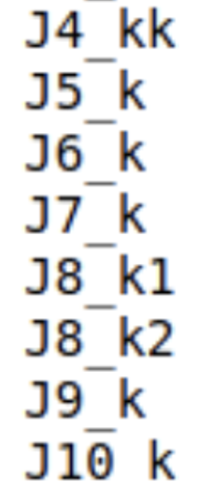
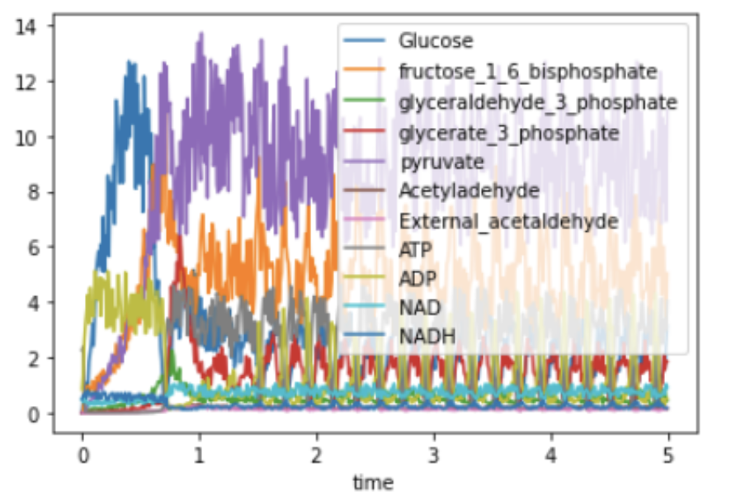
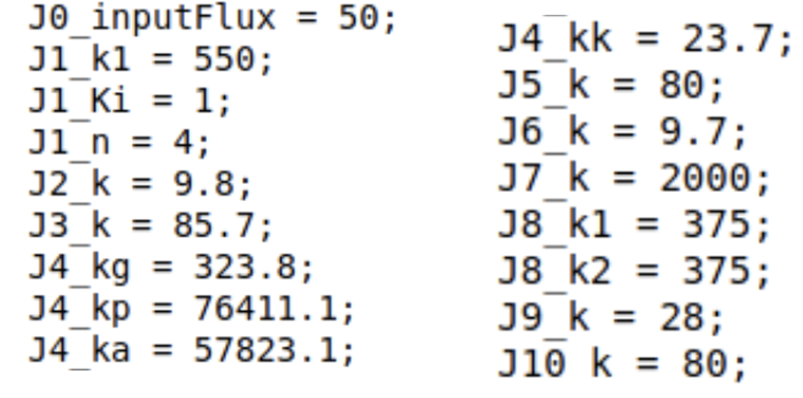
Parameter Fitting Algorithm: Inputs/Outputs
Inputs
model: describes time evolution of species concentrations and fluxes based parameters
parametersToEstimate: parameters to be estimated
observedValues: time course values of species concentrations
Outputs
parameterEstimates: a “good” choice of the values for parametersToEstimate. ”Good” means that the residuals are small.
Notes:
May not have measurements of all floating species or measurements at many time points.
Need a range of parameter values o explore.
Observed values may have noise.

Slide 6
Generic Algorithm for Kinetic Model Parameter Fitting
Inputs
model: describes time evolution of species concentrations and fluxes based parameters
parametersToEstimate: parameters to be estimated
observedValues: time course values of species concentrations
Outputs
parameterEstimates: a good choice of the values for parametersToEstimate
Steps
do until small residuals or exceed runtime limits
parmaterSettings = new assignment of values to parametersToEstimate
simulationResults = run model using settings
residuals = observedValues - simulationResults
if residuals are smaller than previous parameterSettings
parameterEstimates = parameterSettings
if residuals are very small
return parameterEstimates
search algorithm

Slide 7



Concern 1 (Identifiability): Is it possible to determine parameter values from the available data? (Do some parameters have no effect on the data?)
Analogy with “Russian dolls”.
You see one doll.
But you look inside (get more data), and there’s another.
If you look closer still (gather more data), and there are many more.
1903-1957
Notes:
Some humility about the problem being addressed.

Slide 8
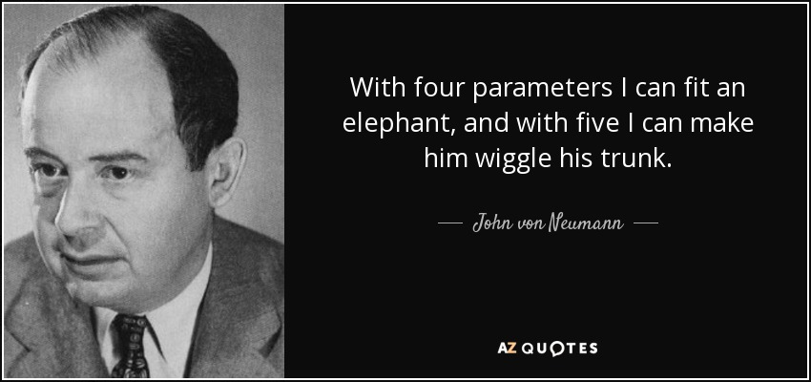
Concern 2 (Overfitting): Fitting a large number of parameters to a small dataset.
1903-1957
Models in Systems Biology almost always have many more than five parameters.
Notes:
Some humility about the problem being addressed.

Slide 9
Concern 3 (Computational Complexity): The explosion of combinations of parameter values makes an optimal search infeasible.
Assume 1 microsecond for a simulation (single assignment of parameter settings).
Calculate log10(# hours) - time to simulate all combinations of parameter settings.
# Parameters
 | 1 | 2 | 4 | 8 | 16 | 32 | 64
2 | -9.3 | -9 | -8.4 | -7.1 | -4.7 | 0.1 | 9.7
4 | -9 | -8.4 | -7.1 | -4.7 | 0.1 | 9.7 | 29
8 | -8.7 | -7.8 | -5.9 | -2.3 | 4.9 | 19.3 | 48.2
16 | -8.4 | -7.1 | -4.7 | 0.1 | 9.7 | 29 | 67.5
32 | -8.1 | -6.5 | -3.5 | 2.5 | 14.5 | 38.6 | 86.8
64 | -7.8 | -5.9 | -2.3 | 4.9 | 19.3 | 48.2 | 106
second | -3.56
hour | 0
day | 1.38
month | 2.86
year | 3.94
century | 5.94
Age of Universe | 14.09
# Possible values for a parameter
Notes:
Exhaustive search is a search algorithm that looks at all combinations of parameter settings.

Slide 10
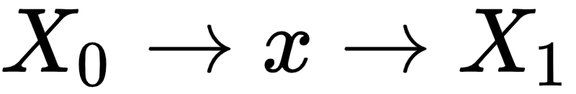
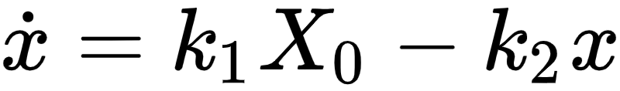
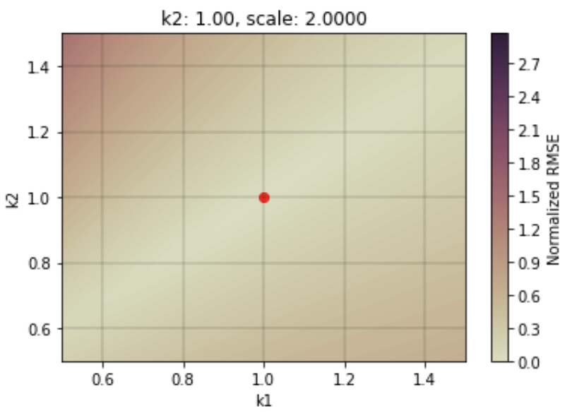
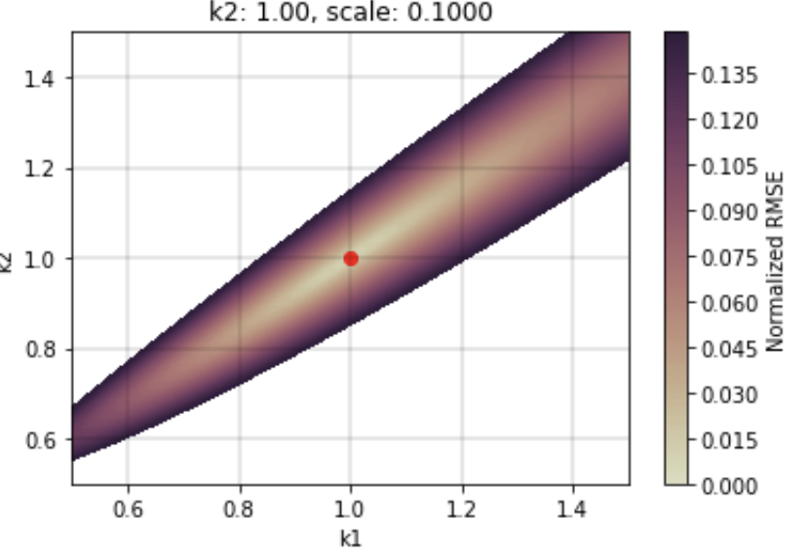
Convex Fitting Surface Overcomes Computational Complexity
Fitting Surface: Sum of square of residuals vs. parameter settings.
Residuals = simulation results using the true settings parameters minus the results using other settings.
Convex fitting surface. Gradient descent finds the best fit.
Avoids computational complexity of exhaustive search.
The fitting surface is a “road map” for a search algorithm.

Slide 11
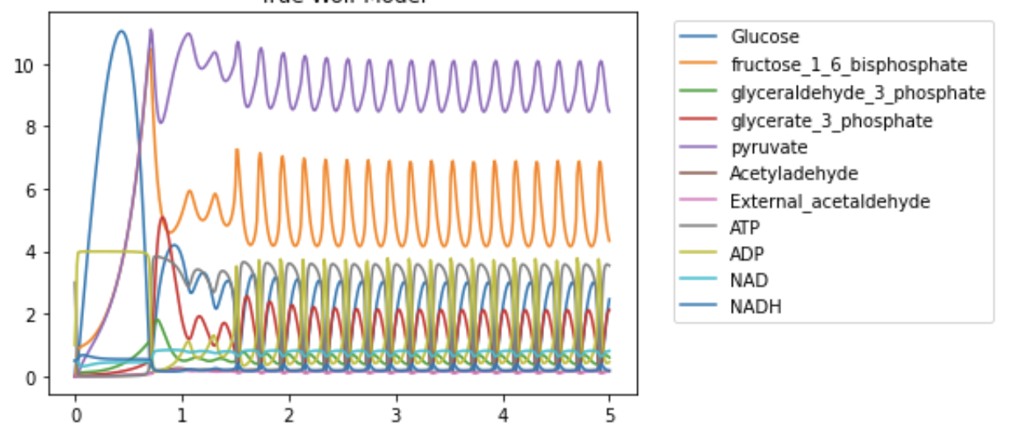
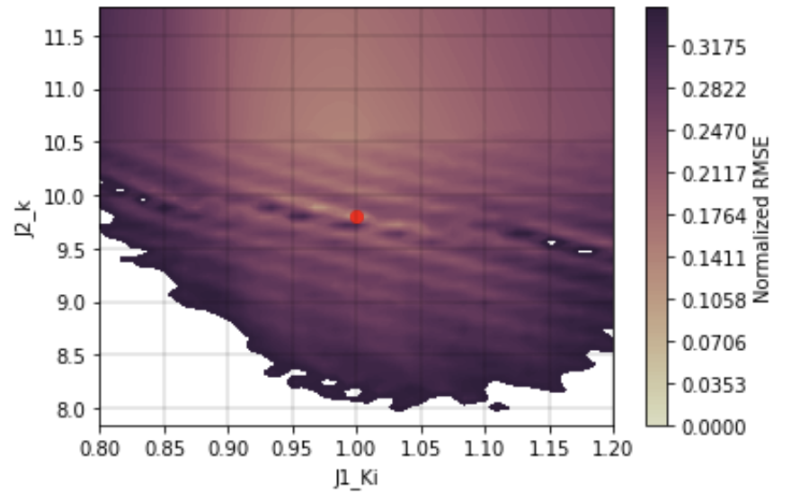
Fitting Surface: Wolf Model
Combinations of J2_k, J1_Ki
Gradient descent can get stuck in ridges.

Slide 12
Factors Affecting Computational Complexity of Fitting
Fitting surface
Number of parameters, number of levels (settings)
Starting point for the search
Search algorithm
2 parameters, 1 species
Glycolytic Oscillations
Parameter fitting is an exploratory data analysis (EDA).

Slide 13
Considerations for Parameter Fitting
Identifiability – Is it possible to find values of parameters from the data?
Overfitting – Are there so many parameters and so little data that the parameters we find are not unique?
Computational complexity – Does the time to explore the space of possible parameter values too large?

